Slide 1

University of Carthage
(Faculty of legal,political and social sciences)
14, avenue hedi karray, centre urbain nord, tunis,1080

Slide 2
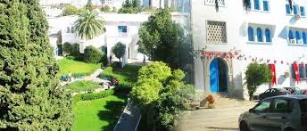

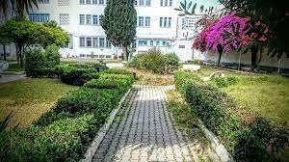
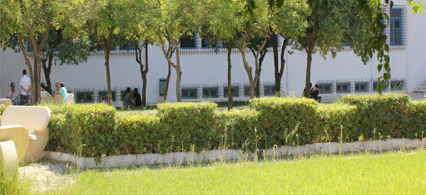

Slide 3
The Faculty of Legal, Political and Social Sciences of Tunis was created by the decree-law n° 87-4 of September 24, 1987, ratified by the law n° 61-87 of November 13, 1987, with the objective of establishing a pole of excellence, exclusively devoted to scientific production and pedagogical supervision.

Slide 4
Our teachers have been and still present and active in the international academic world, in the national political life, in the circle of international, universal or regional organisations, in the circle of non-governmental organisations and in the management of university affairs.

Slide 5
A centre of excellence thanks to a constant student-teacher ratio, high quality teaching, openness to foreign languages and ICT, and the ambitious extension of the third cycle: nine research masters and six professional masters.
The Faculty is also a centre of excellence thanks to an appreciable output and the development of the library and its specialized documentation centres, in particular the European law centre, the environmental law centre, the United Nations law centre and the common law centre.

Slide 6
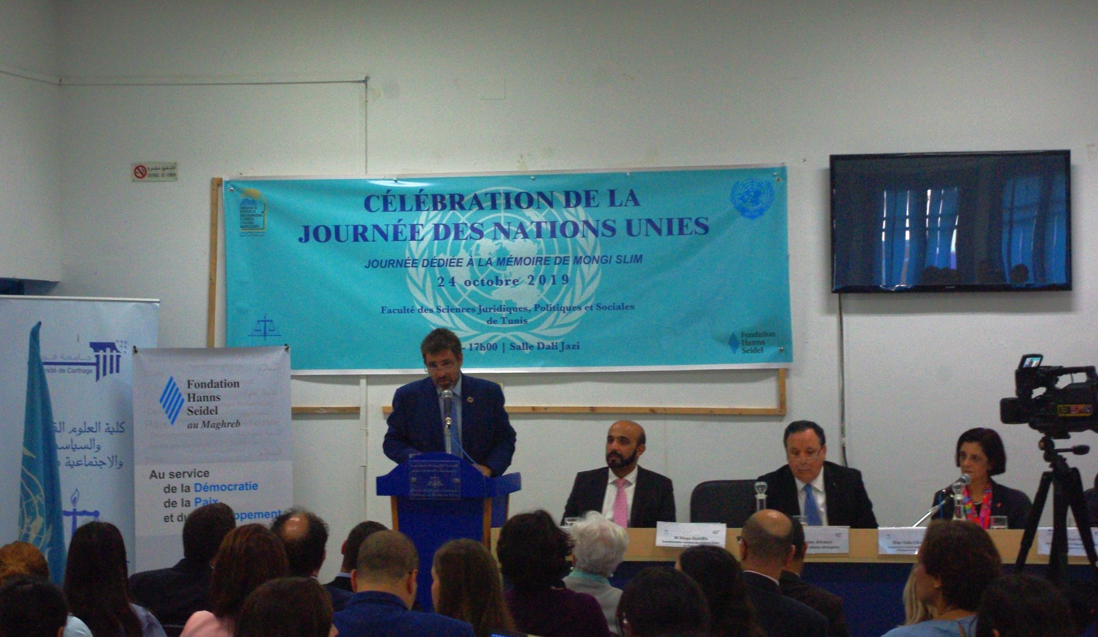
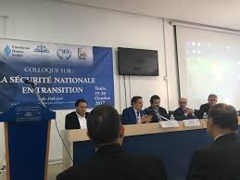
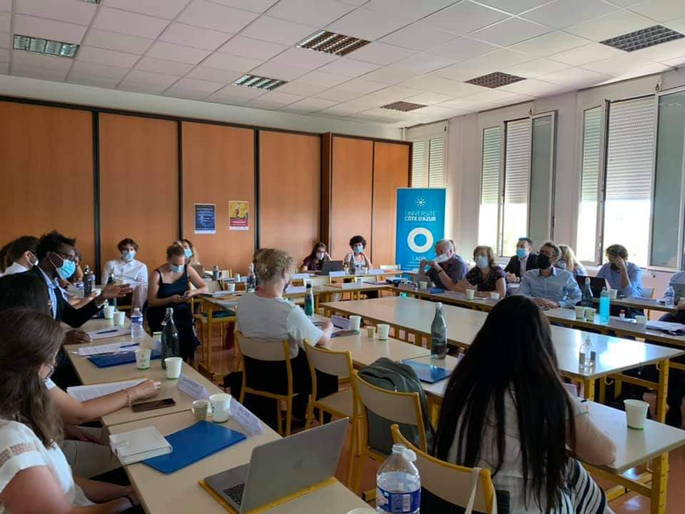


Slide 7
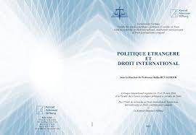




Slide 8
Masters with international aspect :
Master de recherche en sciences politiques (spring session)
-Administration locale
-Economie politique
-Politiques comparées
-Pensées politiques
-Droit financier approfondi
Master de recherche en Common Law (spring session)
-Antitrust Law
-UK corporate law
-US company law
-Anticorruption law
-International contracts

Slide 9
Master de recherche en Droit international et relations Europe-Maghreb (spring session)
-Questions conflits de lois
-Questions conflits de juridictions
-Droit de la nationalité et conditions des étrangers
-Arbitrage
-Droit du commerce international
Master de recherche en l’Union Africaine (spring session)
-Questions contemporaines de droit international Public
-Droit de l’Union Africaine
-Règlement pacifique
-Droit diplomatique et consulaire
-Droit de la coopération judiciaire

Slide 10
Master Professionnel en droits humains et humanitaires (cours de soir) (spring session)
-Droit international approfondi
-Droit international des droits de l’Homme
-Droit international humanitaire
-Traite des etres humains
-Droits humains/Droit des conflits armés et justice

Slide 11
Exams :
-Exams’ Calendar of spring session will be published in last january-first february. Exams session in spring start most of the time in may (1st sessions) and a second one in last may/ first week of june with always around 10/15 days to prepare exams.
-The website of the university is under maintenance : it works but we cannot access with ID number due to technical issues : However the schedules, exam’s calendars, scholarship and every actuality concerning the university and the students will be published in the university and on the website and everyone can acess to check it : http://www.fsjpst.rnu.tn/en/
-Access to Library : Due to sanitary restrictions,we can send an email to the library before 48h to collect books (the references are available online : http://www.biruni.tn/ )

Slide 12
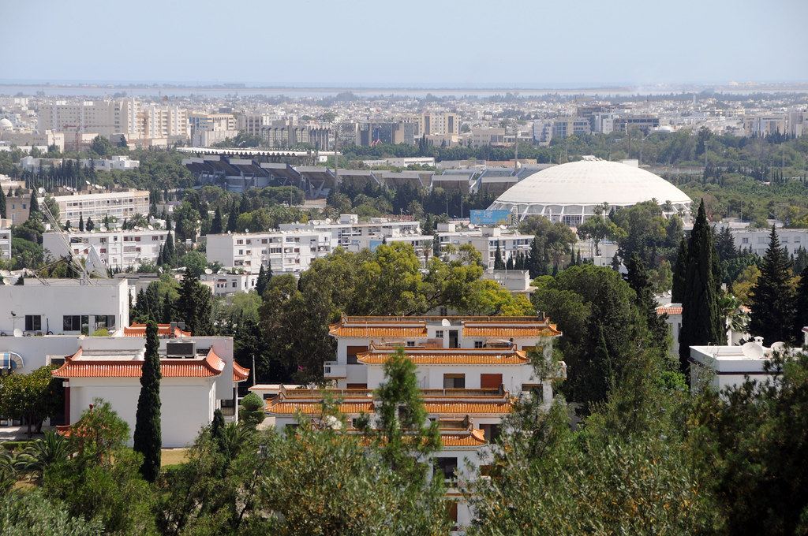
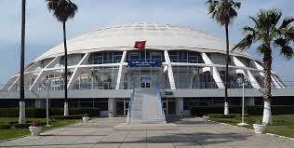
The city :
-The university is near to many accomodations (supermarket, restaurants and coffees with affordable prices, bus and tramvia station, hospital, residential areas).

Slide 13
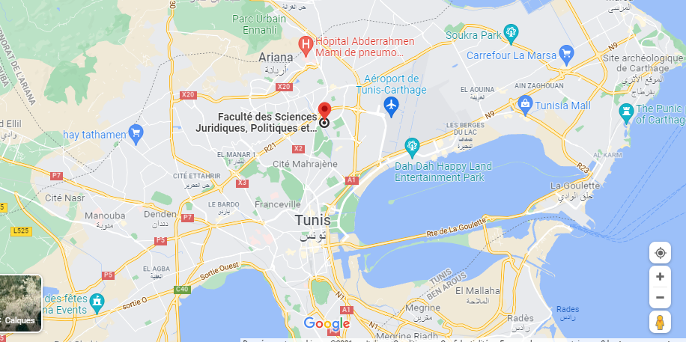

Slide 14


